Slide 1
All you need to know about our mobile repair courses. 10 questions and answers.

Slide 2
Frequently asked questions about The Art of Repair repair bootcamps: 1. Why do you need to introduce ‘repair’ as a service? 2. Why do you need to follow a training? 3. Why would you choose for our training? 4. What are the investments, time and money wise? 5. Do I need to have certain skills to follow this training? 6. Who are the trainers? 7. What kind of repairs can you do with confidence after this training? 8. What are the potential earning of the skills learned at this training? 9. How can you improve your skills? 10. What are the key factors for success? 11. What happens if I fail in repairs?

Slide 3
1. Why do you need to introduce ‘repair’ as a service? For non-repair retail: - In need of additional income source due to more (online) competition for subscriptions/accessories/devices - Clients desire more one-stop-shop service - Repair is an easy way to get more visitors into your store - Relatively low investment - Repair goes retail. Retail needs to go repair. If you snooze, you lose from your competition in your street - If you do it right, it will make you the local hero. - Repair will prepare you to understand other new services, as they arrive to the electronics industry faster than those who don't understand repair.

Slide 4
2. Why do you need to follow a training? - Doing repair without the right skills, will harm your image badly. Besides this, rework will cost you money! - Without physical practice, it takes a long time to master these needed skills - Without the right training, you will never know which equipment, tools and donor devices are right for the job. - With so many different models and technical possibilities nowadays, you really need to understand the basics. - Repair with knowledge will give you the confidence you need to repair, and it will give your customers trust as a repair professional.

Slide 5
3. Why would you choose for our training? - Proven to be successful in giving students confidence to do all sorts of repair. - Only the best trainers from the mobile repair industry! - Both trainers have (had) own shops - A 9,7 satisfaction score out of 10 graduated students! - We have the largest and most advanced lab in the Netherlands.

Slide 6
4. What are the investments, time and money wise? We offer two kinds of trainings: L1/L2 (basic repair): - Min. 40 hours of home study with E-learning - 4 days of physical training (E-learning must be finished) L2/L3 (micro soldering): - Min. 40 hrs. of home study with E-learning - 7 days of physical training (No E-learning necessary, yet)

Slide 7
Modern lab with the latest equipment!

Slide 8
Investments in study time.
L1/L2 time investment
E-learning (home study with videos and assignments) AVAILABLE MAY 2023 | Approx. 40 hours
The physical exam is a 4-day training on location. The first morning it’s time for theory. The rest is practice, practice, practice! | 36 hours
Learn from others by coming to lab or be member of Facebook/WhatsApp groups | On going
L2/L3 time investment
E-learning AVAILABLE MAY 2023 | Aprox 40 hours
The physical exam is a 7-day training on location. The first day it’s time for theory. The rest is practice, practice, practice! | 56 hours
Learn from others by coming to the lab or become a member of Facebook/WhatsApp groups | On going

Slide 9
Content training?
Investment in money
 | L1/L2 investment
1 | E-learning L1/L2 | € 150 per year
2 | L1/L2 physical training | € 1,250 one time
3 | Tools L1/L2 | € 350 one time
 |  | € 1,750 excl. VAT
 | Break even point (á euro 40) | 44 repairs = ~ 2 months
 | L2/L3 investment
1 | E-learning L2/L3 | € 250 per year
2 | L2/L3 physical training | € 2,150 one time
3 | Tools micro soldering | € 1,500 one time
 |  | € 3,650 excl. VAT
 | Break even point (á euro 80) | 46 = 4 months

Slide 10
Time for lots of valuable info!

Slide 11
Start inventory parts
Supported model-series:
iPhone: 7, 8, X, XR, XS, 11, 12, 13 Samsung: S20, S21
L1/L2 part | # | Multiple colours? | Investment
Display | 2 | Yes
Battery | 2 | No
Front camera | 2 | No
Back camera | 2 | No
Speaker | 2 | No
Adhesives | 2 | No
List available per e-mail, please mail to sales@2service.nl

Slide 12
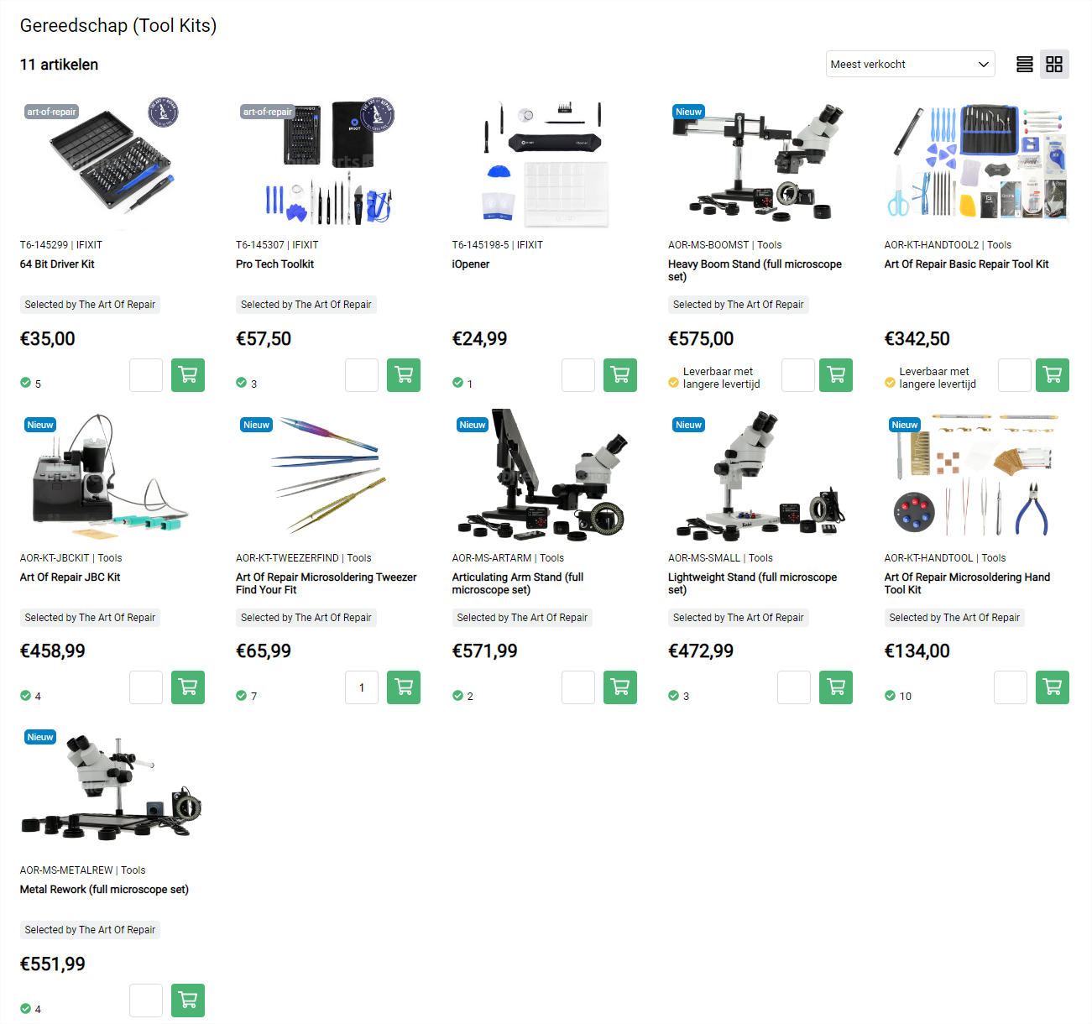
Tools
We have 8 starter kits for L1/L2/L3 repairs. With these kits engineers are ready to go. Link:
https://www.mobileparts.shop/nl/artikelen/gereedschap/categorie:859:tool-kits

Slide 13
What will you learn exactly during the L1/L2 E-learning?
ESD - What is ESD ? - How does ESD arise? - Defects due to ESD? - Precautions to prevent ESD defects - Materials and tools to protect against ESD
The customer - The mechanic as ambassador - Consumer law - Privacy / AVG - Carrying out commercial activities (cross sale)
Apple - Operation and operating system - Common problems - Making a diagnosis (e.g., using and reading multimeter) - Replaced display - Replaced case (back cover) - Connectors and Sensors (basic skills) - Replaced battery
Android - Operation and operating system - Common problems - Making a diagnosis (e.g. using and reading multimeter) - Replaced display - Replaced case (back cover) - Connectors, Cameras, Speakers and Sensors (basic skills) - Replaced battery
Tablets - Operation and operating system - Common problems and recognizing quality - Making a diagnosis (e.g. using and reading multimeter) - Replace display - Connectors and Sensors (basic skills) - Battery
Soldering - What is Soldering (Basic Skills)
Tools, test equipment - What does a workplace look like? - Tools for opening a Smartphone or Tablet - Basic (table) tools - Adjustable power supplies (DC) - Cleaning sets
Parts - Recognizing different qualities for iPhone/iPad - Advice on starting stock and stock management

Slide 14
What will you learn exactly during the L1/L2 physical training?
How do you implement repairs in your services? How do you deal with technical work in your store. 10 tips to be well prepared for this.
Training of all key L1/L2 skills (Apple and Samsung). You will learn the basics of smartphone/tablet repair. After this training you will be able to carry out all screen, battery, speaker and camera repairs with confidence.
What are the tools you use and how do you use them best? We teach you which tools are needed for certain activities. You get all the tricks that are there to repair as efficiently as possible. Every situation is different, every engineer is different. We like to look and think along about the use of the right tools. Whether or not standing in sight of the customer.
Explanation about the different qualities of parts. What differences are there, and which quality is the best choice for which situation? This can be of great benefit to you and the customer.
Advice on starting stock and ordering tips. We will help you with a proposal for a starting stock and give you tips on how to purchase as optimally as possible, without running too much risk of returns and depreciations.

Slide 15
What will you learn exactly during the L2/L3 E-learning?
1.1 Basic Electrical Theory + Schematics: - Motherboard Anatomy - How understanding resistance will guide you all the way through board repair. - Multimeters 101 - All you need to test devices. - Electrical Theory as fast as possible. - Inference Skills - How to navigate a schematic. - Finding things in a schematic. - Board view Navigation & Usage - Basic Electrical Components and how to test them. - Creating & Understanding Community Diagnostic Information
1.2 A-Z Soldering theory with Art of Repair Processes for perfect soldering every time!
1.3 Micro soldering 101 Theory: - Soldering Fume Shop Safety - How Not to Break Things - Eutectic vs Non-Eutectic Alloys - Solder Types & Melting Points - Why Low Melt is not a good option most of the time. - Soldering Play ranges - Preheater Theory ( Freezing Thermal Inertia ) - Thermodynamics of Micro soldering - Heating Theory, Thermal Linkage, Thermal Bandwidth, System Saturation - Points - Angle of Attack: How to aim Hot Air & How to touch the PCB with an Iron - Heatsinks & Insulators - Choosing Tip & Nozzle Size - Kapton & Silicone Tapes - Board Level Obstacles - Parallel Line Theory - Component Harvesting Theory
1.4 Micro soldering 101 In Practice: - Cleaning Epoxies, Soft Coatings, Hard Coatings - EMI SHIELD REMOVAL THEORY ( Low, Med, High Temp ) - Gravity Vs Antigravity methods of Component Harvesting - The Reallow of Joints - Good Joints vs Bad Joints - Removing Excess Solder - Removing Spent Flux - Dealing with hard-to-reach components. - 1-3 Jointed Components - Low-Density Components “FPCs, Gate Connectors, SD & Sim Card Trays.” - Hooked Tweezers & Harvesting BGA Type Components. - Epoxy & Jumpers - Reballing Theory & Practice - Why do some pads have larger amounts of solder than others? - Reapplication of BGA & Similar Components - IC Triangulation

Slide 16
What will you learn exactly during the L1/L2 physical training?
Within 7 days you will learn all the ins and outs about micro soldering. This course is for repairers who want to start with micro soldering as well as for repairers who already know a thing or two about it. Justin and Quirijn give you all the tools you need to improve yourself and they give you live advice based on your personal skills.
To become a pro in micro soldering, you also need to master L2 repairs. That is why during the course, for example, the 5 parts of L2 repairs will also be discussed:
Heat
Separation
Residual clean-up
Adhesives
Sealing
The trainers take you through all the basic skills needed to make 75% of all L3 repairs that occur in your shop. In addition, you will get the tools to master the last 25% quite easily in your own time. You will learn the theory of micro soldering 101 and will later put it into practice (102). This part of the course will be much more intensive with a lot of theory and hands-on work.
After this course you will know everything about tools, the microscope, thermodynamics and how to work with them. You are also able to replace an IC chip, you know everything about EMI shields, you learn everything about BGA stencils, the placement of a BGA or QFN, epoxy and jumpers. In other words, you know all concepts, theory, actions and the correct way of working from A to Z.

Slide 17
5. Do I need to have certain skills to follow this training? No experience needed for this training! Just wanting to learn is enough.

Slide 18
6. Who are the trainers?
Justin is a passionate tech and repair enthusiast. He built his own repair shops and brand from the US for many years and can be counted among the best mobile engineers in the world. Justin has shared his techniques and knowledge with the world through his YouTube channel 'The Art of Repair'. Today, the Art of Repair channel has over 30K+ subscribers and contains over 150 videos. Behind the scenes, Justin works with anyone willing to work hard for the repair community. This has taken him all over the world where he has met amazing people who love repair as much as he does. | Quirijn is 30 years old, has a thriving repair shop and has almost 18 years of experience in the field of repairing appliances, has lived longer with than without repairing appliances. Yet Quirijn, like almost every other entrepreneur, started with just a passion, a dream and an attic room. Quirijn now has more than 5 years of experience in providing training and can confidently be counted among the best engineers in the Netherlands. Quirijn is now affiliated with The art of Repair and will provide all training in the Netherlands together with Justin.

Slide 19
7. What kind of repairs can you do with confidence after this training? L1/L2: - Display, speaker and battery repairs on iPhone/iPad and Android phones - You'll learn the basics that can be used for other repairs (TV, etc.) L2/L3: - You can change an IC on a motherboard. - You'll learn the basics that can be used for other repairs (TV, etc.)

Slide 20
Get a graduation certificate that has value!

Slide 21
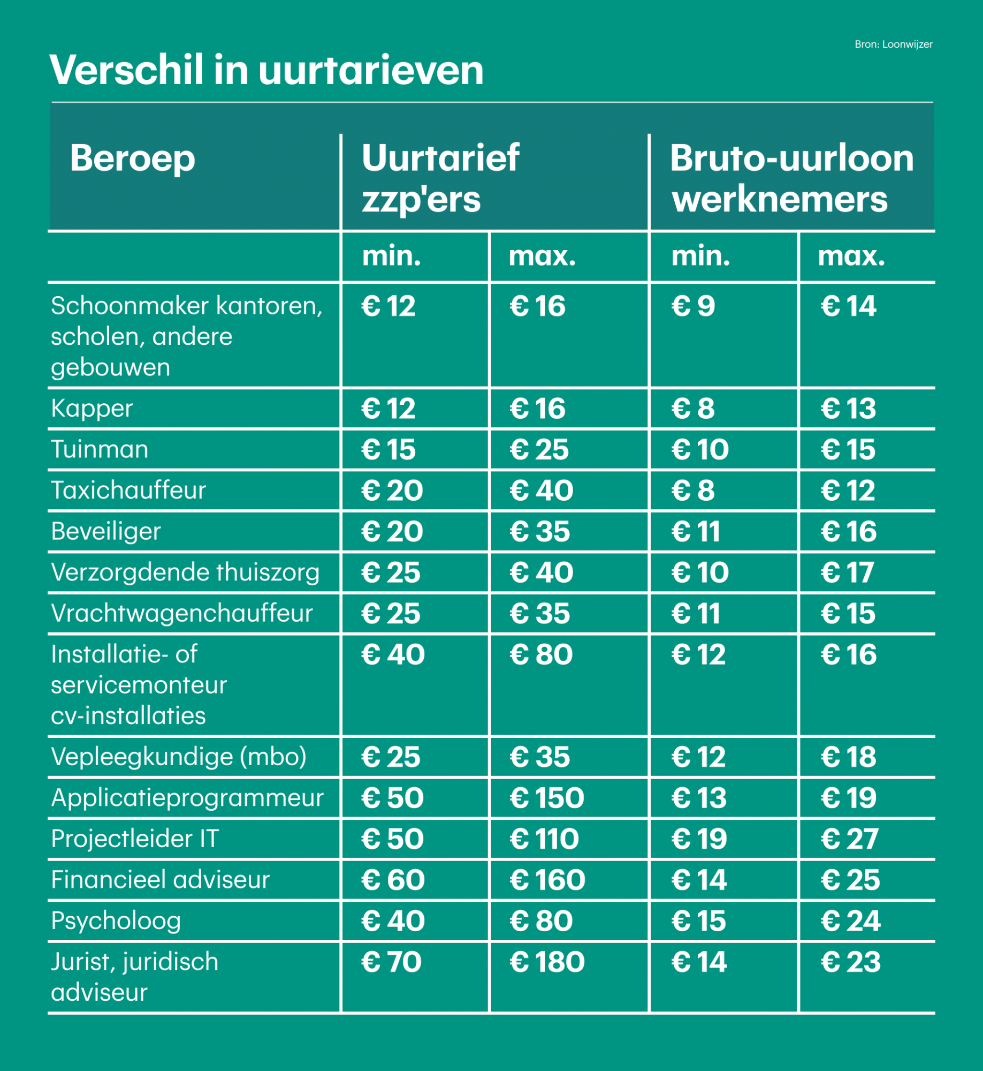
8. What are the potential earning of the skills learned at this training? - Potential earning: € 40.- per repair done in 30 minutes. Your hourly fee is around € 80.- for a L1/L2 repairs. For an L3 repair it’s around € 160.- L1/L2: € 80 per uur (Advised FT salary: € 2.200 tot 3.000) L2/L3: € 160 per uur (Advised FT salary: € 2.500 tot 3.500)

Slide 22
9. How can you improve your skills? - L2/L3 after L1/L2 (micro soldering) - Be active in Facebook groups/Reddit (ask questions there) - Keep up-to-date with blogs / podcasts/ AOR YouTube channel - You’re always welcome to our lab to practice or to bring your own repairs and do them there. (bring your own repairs and do them here) - Interact with the WhatsApp groups created for you and your fellow techs by AOR - Watch the E-learning again as repetition is key, but also because the E-learning will be continuously be updated with new knowledge. - If you continually document your work, diagnostics will burn into your mind. - Use the skills you have to make teardown videos to help others in the industry. - Write your own blogs aimed at your local market and consult your new repair friends on the techniques you have learned, so you can learn more while you write your blog. - HELP THOSE AROUND YOU WITH YOUR KNOWLEDGE

Slide 23
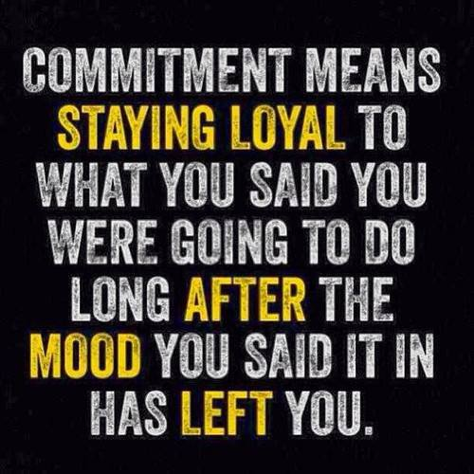
10. What are the key factors for success? - Real motivation because you want to master these skills, not because you were asked to do this. - Time to invest. Do you really have the time or are you willing to make time? - Don’t go too fast, step by step. - Motivate you employees, give incentives.

Slide 24
11. What happens if I fail in repairs?
You can’t and won’t!
Do you need help with your repairs? The Mobileparts.shop engineers are always here to help you out, so you can keep your promise to your customers! More info is to come.

Slide 25
March 2023
REGISTER HERE FOR THE COMING COURSE!

